Slide 1
The Phoenix Force
The Student Recreation Center
Tierra Binford, Jade Brown, Keith Camp, Noah Smith, Elise Timmons, Levi Walton

Slide 2
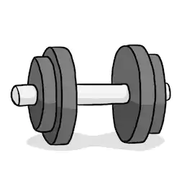
Key Points
Problem Statement
Product Position Statement
Product Overview
Product Features
Product Requirements
Stakeholder Analysis
Stakeholder Needs
Feasibility Considerations
As-is and To-be
Numbers

Slide 3

Problem Statement
This project will help solve the locker, email, and user problems. Currently, email addresses are written on paper and sometimes users emails are entered wrong and they don’t get updates. The new system will allow users to enter their information online.
The Problem Of: The SRC is currently using paper to do most of their documentation.
Affects: Expired lockers still have stuff in them.
The Impact Of Which Is: Users don’t know when their lockers expire and lose their stuff.
A Successful Solution Should Be: Create a registration system that can be used to better notify users of their locker status.

Slide 4

Product Position Statement
We want our project to improve the workflow of the Student Recreation Center. We strive to provide all of the features needed to bring the workflow to the highest levels possible. Hopefully, by the end our clients are completely satisfied.
For: The Student Recreation Center
Who: Improve the user and worker experience.
The (Product Name): Is a web application.
That: Will make it easier for the SRC to do business.

Slide 5
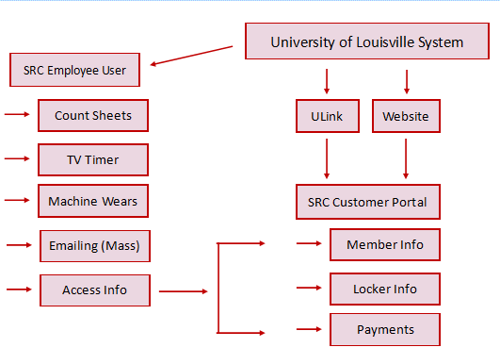
Product Overview

Slide 6
Product Features
Allow for SRC staff to maintain client locker rental [priority]
Allow for SRC staff to track machine maintenance [priority]
Allow for SRC staff to track machine usage [priority]
Allow for SRC staff to track usage of SRC facilities demographically [priority]

Slide 7
Product Requirements
Content management system, used to manage web interface.
Payment management system, used to allow clients to regulate payment for locker rentals.
Database system, used to store locker rental data, machine management and usage data.
Devices for SRC staff, used to manipulate the data for locker rentals and machine usage and management data.

Slide 8
Stakeholder Analysis
Non - user stakeholders
SRC Management
End user stakeholders
Employees
Locker Users
Customers
Potential Customers

Slide 9
Stakeholder Needs
Locker Rental
Better maintain tracking of locker rentals in a centralized system to each registered member
Some type of reminder (email) when membership is about to expire
Track Machine Maintenance
Automate and track the maintenance and repairs on gym equipment (life cycle)
Track Machine Usage
Track how much the machines are being used
Track SRC Facilities Usage demographically
To conduct an analysis on which type of members use the SRC
Will help the SRC to appeal to their members more based on their demographics

Slide 10
Feasibility Considerations
If machine wearforms cannot be automated, system that can read reports will be needed.
If count sheets cannot be automated, system that can read reports will be needed.
If TV’s cannot connect to one universal control, new TV’s that can should be purchased.

Slide 11
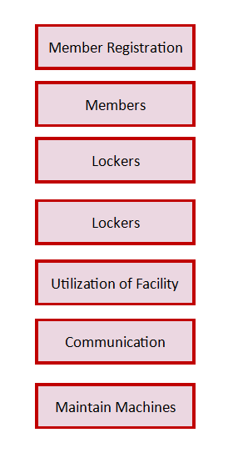
As-is
To-be

Slide 12
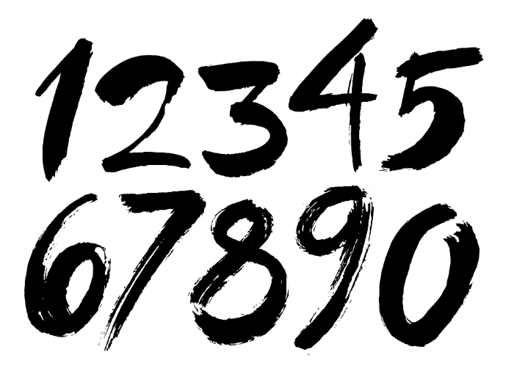
Numbers
Paper: Possible savings of over $1,000.
Labor: Possible savings of over $2,500.

Slide 13
Review
What are the problems?
What are the answers?
How will we provide the answers?

Slide 14

Any Questions?

